Slide 1
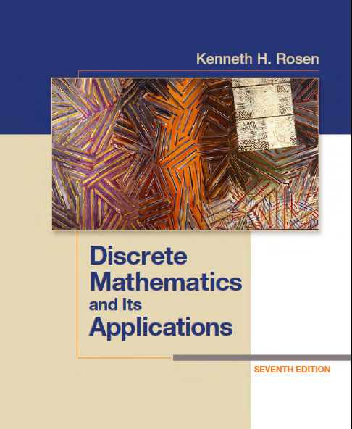
Discrete Math
Haiming Chen
Associate Professor, PhD
Department of Computer Science,
Ningbo University
http://www.chenhaiming.cn

Slide 2
Curriculum Progress
Part I：Logic （Thinking in Mathematics）
Propositional Logic, Predicates and Quantifiers
Definition, Theorem, Corollary and Proofs (Induction)
Part II：Combinatorial Counting
The Basic of Counting
The Pigeonhole Principle
Permutation and Combination
Binomial Coefficients and Combinations
Lists and Sequences (Recursive Definition /Recurrence Relations)
Part III: Discrete Structure
Sets
Functions
Relations
Graphs
Trees
Part IV: Algebra
Algebra (Groups) *
Boolean Algebra

Slide 3
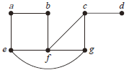
Spanning Trees
a connected subgraph with the minimum number of edges containing all vertices of the original simple graph

Slide 4
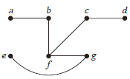
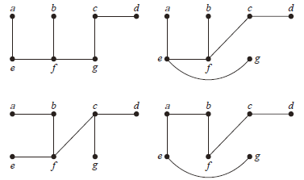
Spanning Trees
Let G be a simple graph. A spanning tree of G is a subgraph of G that is a tree containing every vertex of G.

Slide 5
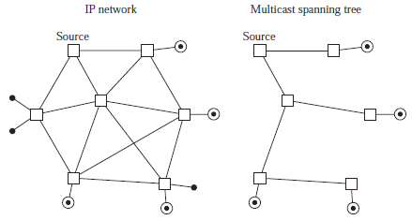
Spanning Trees

Slide 6
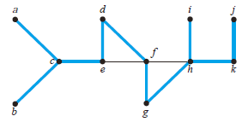
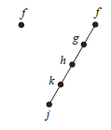

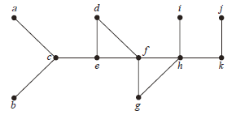
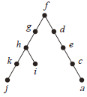
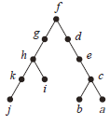
Depth-First Search
Tree Edges
Back Edges

Slide 7
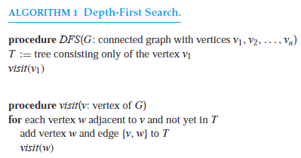
Depth-First Search

Slide 8
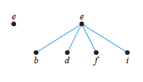
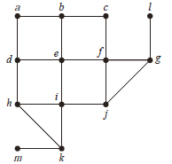
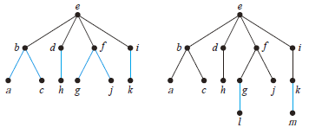
Breadth-First Search

Slide 9
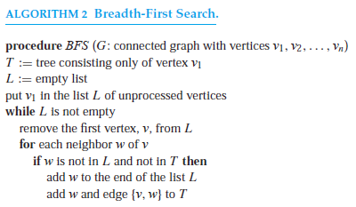
Breadth-First Search

Slide 10
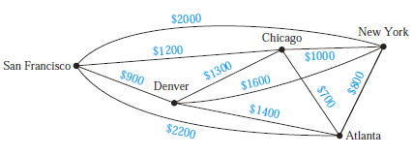
Minimum Spanning Trees
How to ensure that there is a path between any two computer centers so that the total cost of the network is minimized?

Slide 11
Minimum Spanning Trees
Finding a spanning tree so that the sum of the weights of the edges of the tree is minimized.
A minimum spanning tree in a connected weighted graph is a spanning tree that has the smallest possible sum of weights of its edges.

Slide 12
Prim’s algorithm
Begin by choosing any edge with smallest weight, putting it into the spanning tree.
Successively add to the tree edges of minimum weight that are incident to a vertex already in the tree, never forming a simple circuit with those edges already in the tree.
Stop when n − 1 edges have been added.

Slide 13
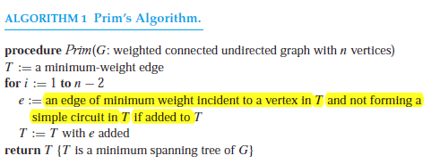
Prim’s algorithm

Slide 14
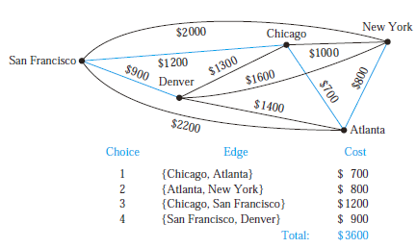
Prim’s algorithm

Slide 15
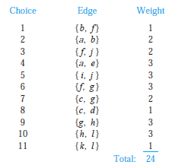
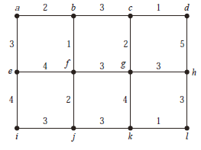
Prim’s algorithm

Slide 16
Kruskal’s algorithm
Choose an edge in the graph with minimum weight.
Successively add edges with minimum weight that do not form a simple circuit with those edges already chosen.
Stop after n − 1 edges have been selected.

Slide 17
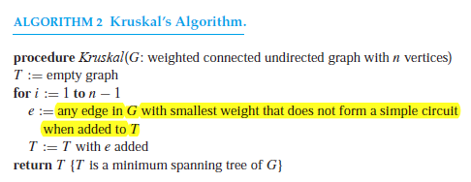
Kruskal’s algorithm

Slide 18
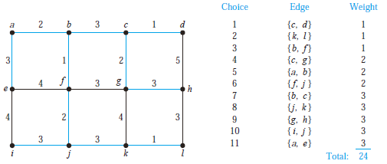
Kruskal’s algorithm

Slide 19
Homework
Chapter 11.4
14, 16 (only for 14)
Chapter 11.5
2, 8

